Slide 1
The 80486 processor

Slide 2
Features
In 1989 Intel released the 8048.
Highly integrated package.
80386-like microprocessor.
80387-like numeric coprocessor.
8K-byte cache memory system.

Slide 3
Internal structure of 80486 modified so about half of its instructions executed in one clock instead of two clocks.
  in a 50 MHz version, about half of instructions executed in 25 ns (50 MIPs)
  50% over 80386 operated at same clock speed
Double-clocked 80486DX2 executed instructions at 66 MHz, with memory transfers at 33 MHz.
  called a double-clocked microprocessor

Slide 4
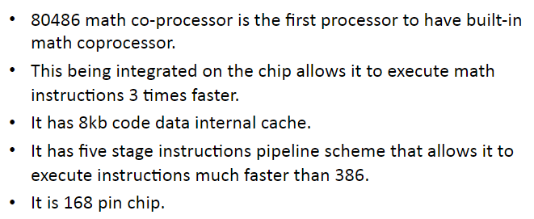

Slide 5
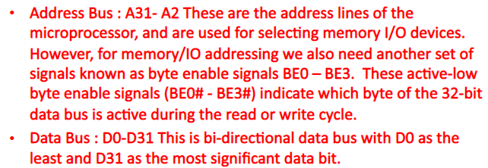
Signals of 80486

Slide 6
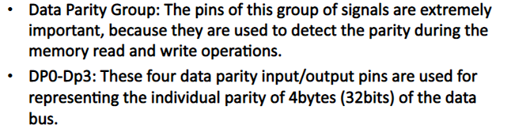

Slide 7
